Slide 1
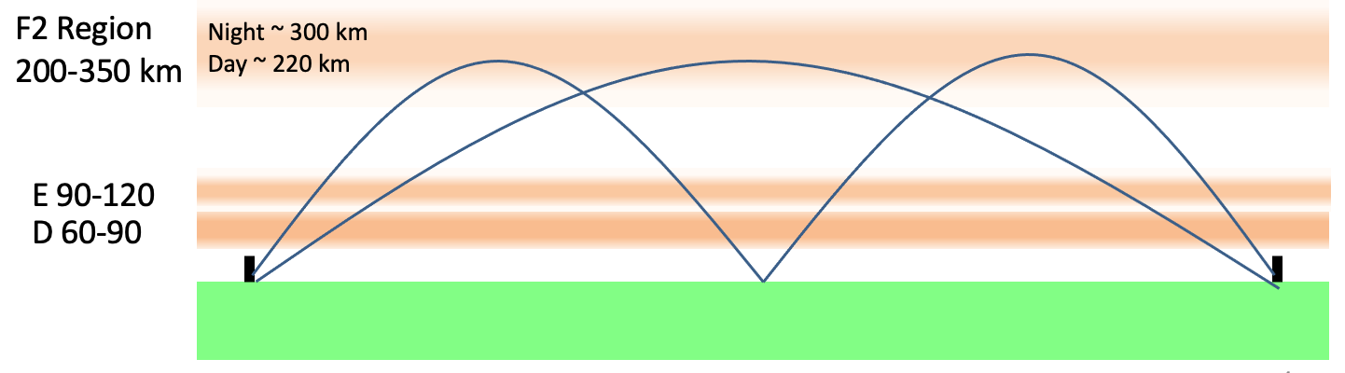
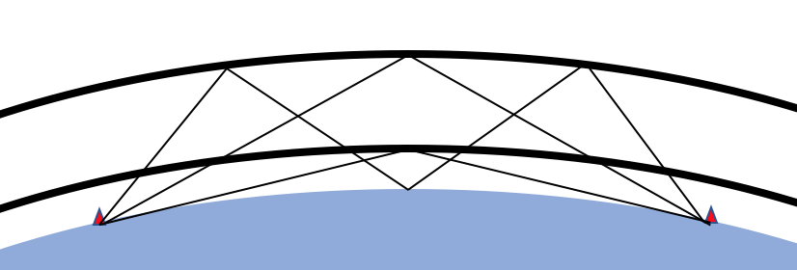
Fig 1a. 1- and 2-hop Refraction from the F2 Layer.
Path Lengths and Times of Flight
1350 km Ground Distance
TOF-mS
F2 Region
3-hop
10.0
F2
8.33
h
E Region
6.67
E
0.67
1.10
5.00
Ground Distance
3.33
Fig 1b. Virtual Height model Used to Calculate Relationship between Virtual Height h and Path Length.
Time of Flight = Path Length / c
Fig 1c. TDOA Example: At 1350 km ground distance the Time Difference of Arrival between 1 and 2 hop modes is 0.67 ms at 225 km layer height and 1.10 ms at 300 km.
Notes:
The pictorial on the left depicts 1 and 2 hop modes from the F layer and a 1 hop mode for the E layer. For a fixed ground distance between TX and RX the propagation path is a function of ionization layer height and number of hops. Doppler shift can be caused by a changing path length, driven by ascending or descending layer height. A virtual height geometric model was used to relate path length to layer height for a given ground distance.

Slide 2
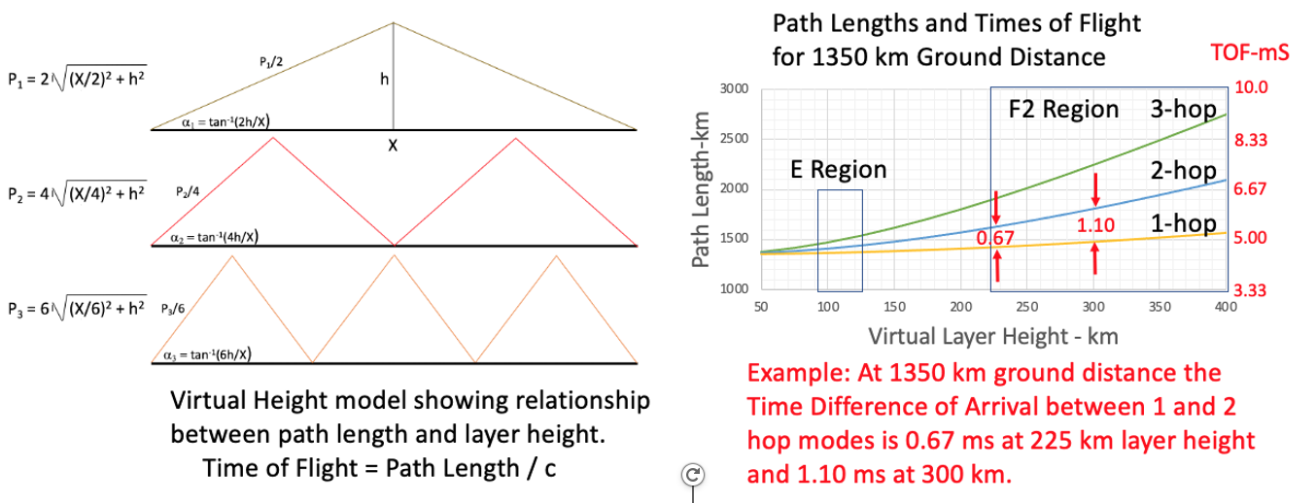
Time Difference of Arrival (TDOA) Between the 1-hop and 2-hop Modes Can be Analyzed to Infer Layer Height
A Virtual Height model of the ionosphere yields simple formulas relating path length to virtual layer height (left). Once path Length is converted to TOF, the TDOA between the 1- and 2- hop modes can be used to infer F2 layer height (right).

Slide 3
Simplified 1 and 2 Hop Refraction from The F2 Region
F2 Region
200-330 km
Day ~ 300 km
Night ~ 220 km
E 100-115
D 60-90
Great Circle Ground Distance
UV and X radiation from the sun photoionize the upper atmosphere into free electrons and positively charged ions.
Complex photochemical reactions with oxygen, ozone, nitrogen, and nitrous oxide arrange the ionization into layers labeled D, E, and F (F1 and F2).
Velocity gradients in the ionized layers refract upward directed radio waves back to earth. Multiple hops involving reflection from the earth and other layers are possible, enabling global radio propagation.
Most HF radio propagation comes from the E and F layers. The D layer primarily acts as an attenuator with attenuation increasing with wavelength.
Notes:
UV and X radiation from the sun photoionize the upper atmosphere into free electrons and positively charged ions.
Complex photochemical reactions with oxygen, ozone, nitrogen, and nitrous oxide arrange the ionization into layers labeled D, E, and F.
Velocity gradients in the ionized layers refract upward directed radio waves back to earth in the HF frequency range from 3-30 MHz.
Multiple hops involving reflection from the earth and other layers are possible, enabling global radio propagation.
Most HF radio propagation comes from the E and F layers. The D layer primarily acts as an attenuator with attenuation increasing with wavelength.
The F layer changes height significantly with diurnal changes in solar radiation. The E layer does so as well, but to a much smaller degree. The rate of height change imparts velocity on path length which results in Doppler shifts in frequency.
This paper postulates a phenomenology to explain observed complex Doppler behavior, specifically mode splitting, as a function of differential path velocity imparted on single and multiple hop modes by changing layer height.

Slide 4
Simultaneous 1 Hop Refraction from the E and F2 Regions
F2 Region
200-330 km
Day ~ 300 km
Night ~ 220 km
E 100-115
D 60-90
Great Circle Ground Distance
UV and X radiation from the sun photoionize the upper atmosphere into free electrons and positively charged ions.
Complex photochemical reactions with oxygen, ozone, nitrogen, and nitrous oxide arrange the ionization into layers labeled D, E, and F (F1 and F2).
Velocity gradients in the ionized layers refract upward directed radio waves back to earth. Multiple hops involving reflection from the earth and other layers are possible, enabling global radio propagation.
Most HF radio propagation comes from the E and F layers. The D layer primarily acts as an attenuator with attenuation increasing with wavelength.
Notes:
UV and X radiation from the sun photoionize the upper atmosphere into free electrons and positively charged ions.
Complex photochemical reactions with oxygen, ozone, nitrogen, and nitrous oxide arrange the ionization into layers labeled D, E, and F.
Velocity gradients in the ionized layers refract upward directed radio waves back to earth in the HF frequency range from 3-30 MHz.
Multiple hops involving reflection from the earth and other layers are possible, enabling global radio propagation.
Most HF radio propagation comes from the E and F layers. The D layer primarily acts as an attenuator with attenuation increasing with wavelength.
The F layer changes height significantly with diurnal changes in solar radiation. The E layer does so as well, but to a much smaller degree. The rate of height change imparts velocity on path length which results in Doppler shifts in frequency.
This paper postulates a phenomenology to explain observed complex Doppler behavior, specifically mode splitting, as a function of differential path velocity imparted on single and multiple hop modes by changing layer height.

Slide 5
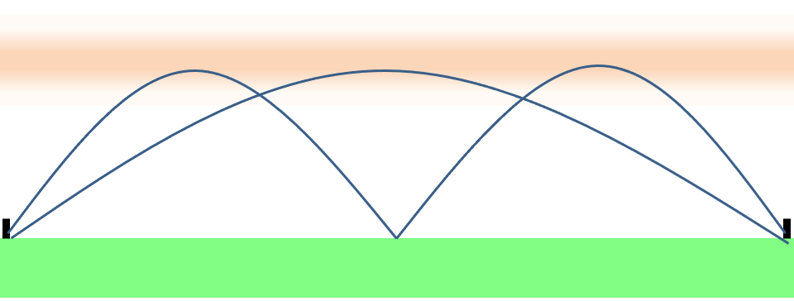
Computer with .wav Chirp Waveform
Sound
Card
Output
Mic
Input
Interface
HF
Transmitter
F2 Region
200-350 km
Night ~ 300 km
Day ~ 220 km
E 90-120
D 60-90

Slide 6
Notes:
UV and X radiation from the sun photoionize the upper atmosphere into free electrons and positively charged ions.
Complex photochemical reactions with oxygen, ozone, nitrogen, and nitrous oxide arrange the ionization into layers labeled D, E, and F.
Velocity gradients in the ionized layers refract upward directed radio waves back to earth in the HF frequency range from 3-30 MHz.
Multiple hops involving reflection from the earth and other layers are possible, enabling global radio propagation.
Most HF radio propagation comes from the E and F layers. The D layer primarily acts as an attenuator with attenuation increasing with wavelength.
The F layer changes height significantly with diurnal changes in solar radiation. The E layer does so as well, but to a much smaller degree. The rate of height change imparts velocity on path length which results in Doppler shifts in frequency.
This paper postulates a phenomenology to explain observed complex Doppler behavior, specifically mode splitting, as a function of differential path velocity imparted on single and multiple hop modes by changing layer height.

Slide 7
Computer with .wav Chirp Waveform
Computer with .wav Capture Program
Sound Card Output
Sound Card Input
Mic Input Interface
Audio Output
AM or SSB
HF Transmitter
Skywave path with ground distance and operating frequency suitable for multi-hop propagation.
AM or SSB
HF Receiver

Slide 8
Computer with .wav Chirp Waveform
Computer with .wav Capture Program
Sound Card Output
Sound Card Input
Mic Input Interface
Ground Distance = 317 km
Audio Output
WA5FRF SSB
HF Transmitter Near San Antonio, TX
N5DUP SSB
HF Receiver Near Abilene, TX
Skywave path with ground distance and operating frequency suitable for multi-hop propagation.
Frequencies for initial tests: 3.780 and 5.3715 MHz

Slide 9
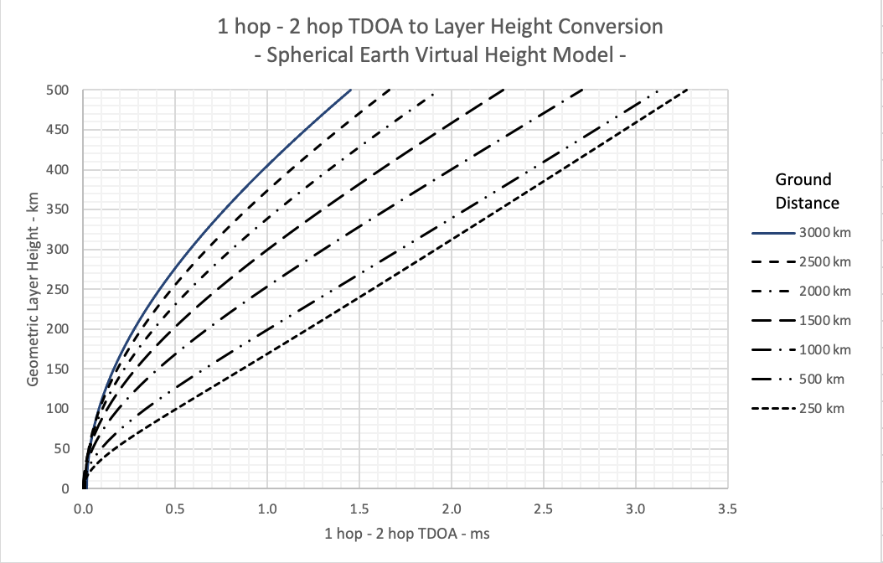
Calculated Relationship Between 1 hop-2 hop Time Difference of Arrival and Virtual Layer Height for Ground Distances Between 250 km and 3000 km
1 hop – 2 hop TDOA to Layer Height Conversion
- Spherical Earth Virtual Height Model -
F2
Virtual Height - km
F1
E
D
1 hop – 2 hop Time Difference Of Arrival - ms

Slide 10
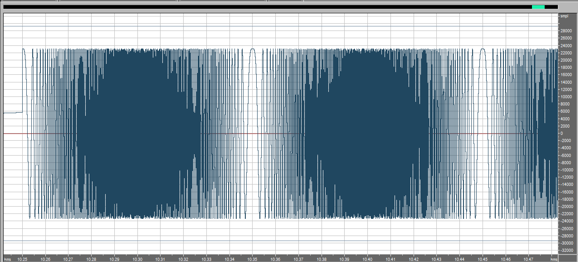
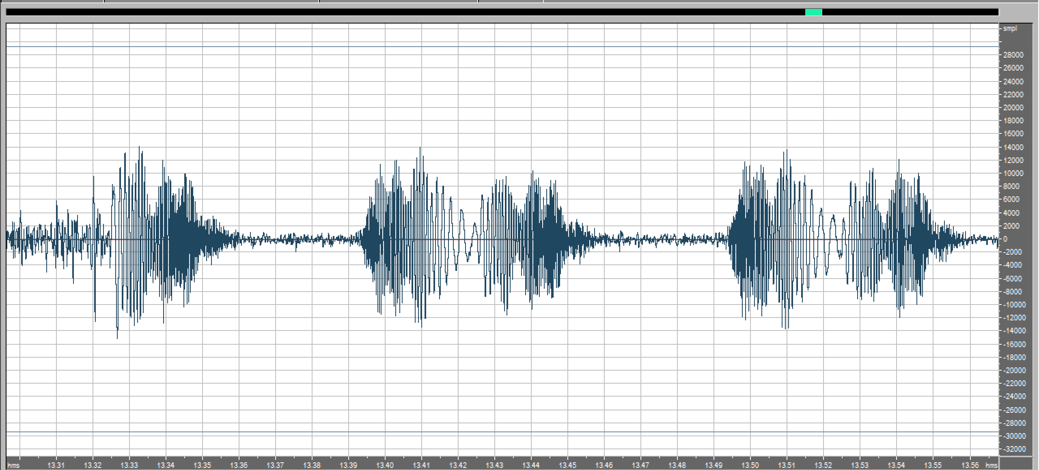
0-5000 Hz Up-Down Chirps Illustrate Bandwidth Limiting in Transmitter And Receiver
Up-Down Chirps Have Constant Amplitude in Source File
Received Envelope Amplitude Shows < 3000 Hz Passband

Slide 11
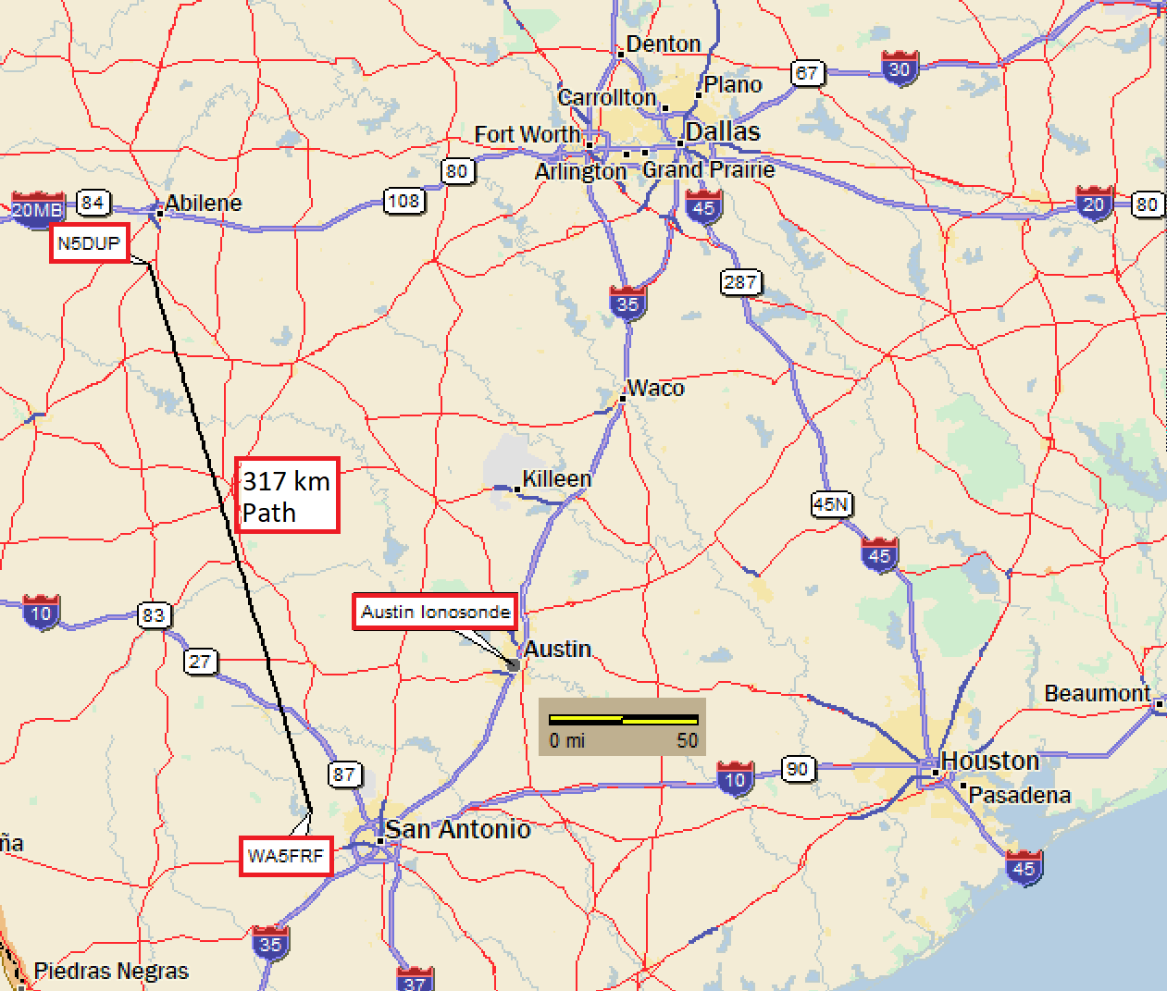
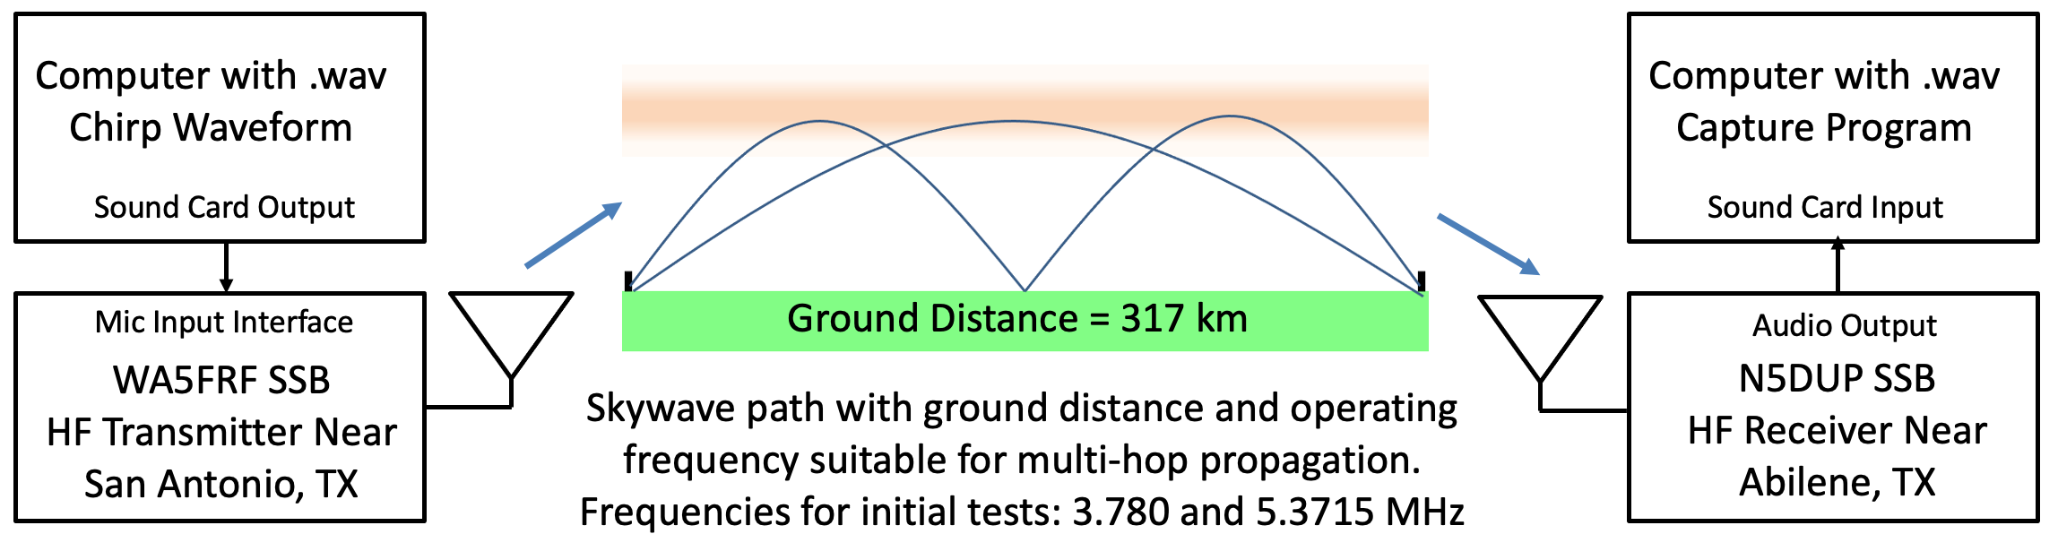
Geometry and Setup for Initial TDOA On-Air Experiments Using Amateur Radio Stations
Geometry chosen for proximity to expected eclipse Path of Totality and Austin Ionosonde for ground truth data.
60 m and 75 m frequency bands chosen for likelihood of both 1 hop and 2 hop propagation.

Slide 12
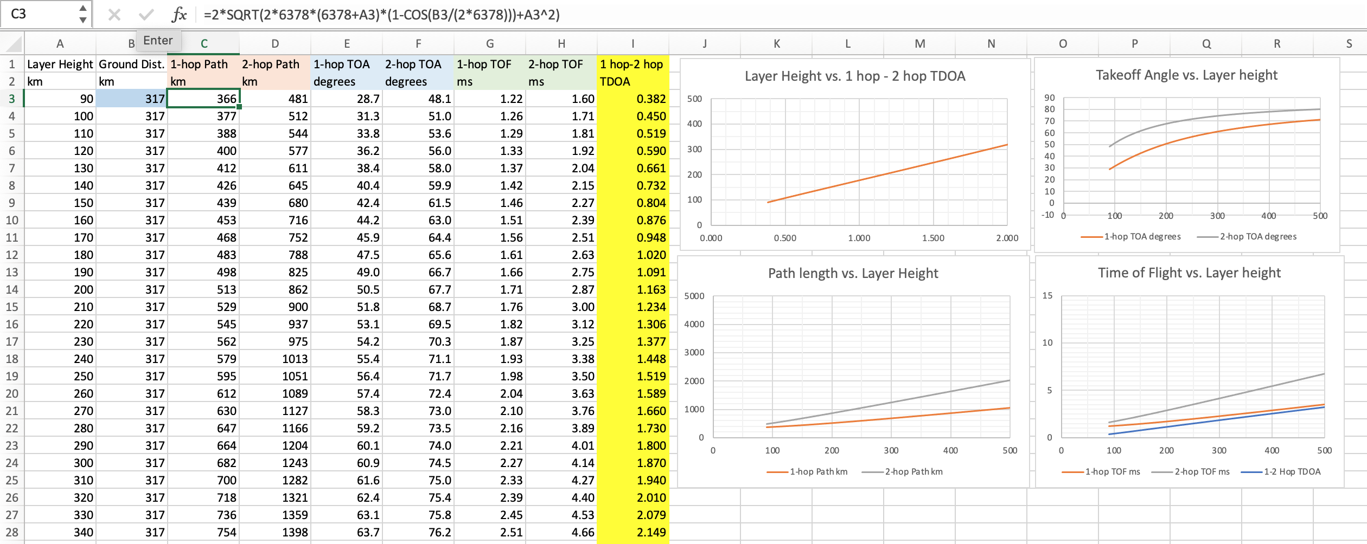
Spreadsheet for Calculating TDOA Parameters for a Specified Ground Distance
Spherical Earth Virtual Height Model

Slide 13
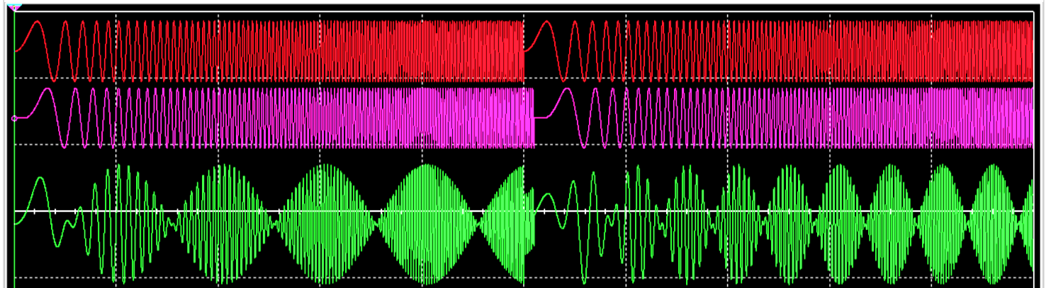
The Time Difference of Arrival between Two Simultaneous Propagation Modes Measured by Transmission of an Audio Frequency Chirp
1 ms Time Delay. Δf = 100 Hz
2 ms Time Delay. Δf = 200 Hz
100 Hz/ms Chirp @ 0 delay
(Fast Chirp)
B. Chirp delayed 1 and 2 ms
C. SUM (A+B). Beats occur at period 1/Δf. Summation occurs naturally in receiver
during multipath reception.
10ms=1/100Hz
SPICE Simulation
Time base : 10 ms/div
5ms=1/200Hz
Summation of a linear chirp with a delayed copy of itself produces a difference frequency at Δf = Sweep Rate * Δt.
Beat pattern has a period p = 1/Δf. The Time Difference of Arrival (TDOA) can be calculated by:
TDOA = 1/ p*Sweep Rate
Example: two 100 Hz/ms chirps 1ms apart produce a difference frequency of 100Hz, which has a period of 10 ms.
TDOA = 1/(10 ms * 100 Hz/ms) = 1 s/1000 = 1 ms

Slide 14
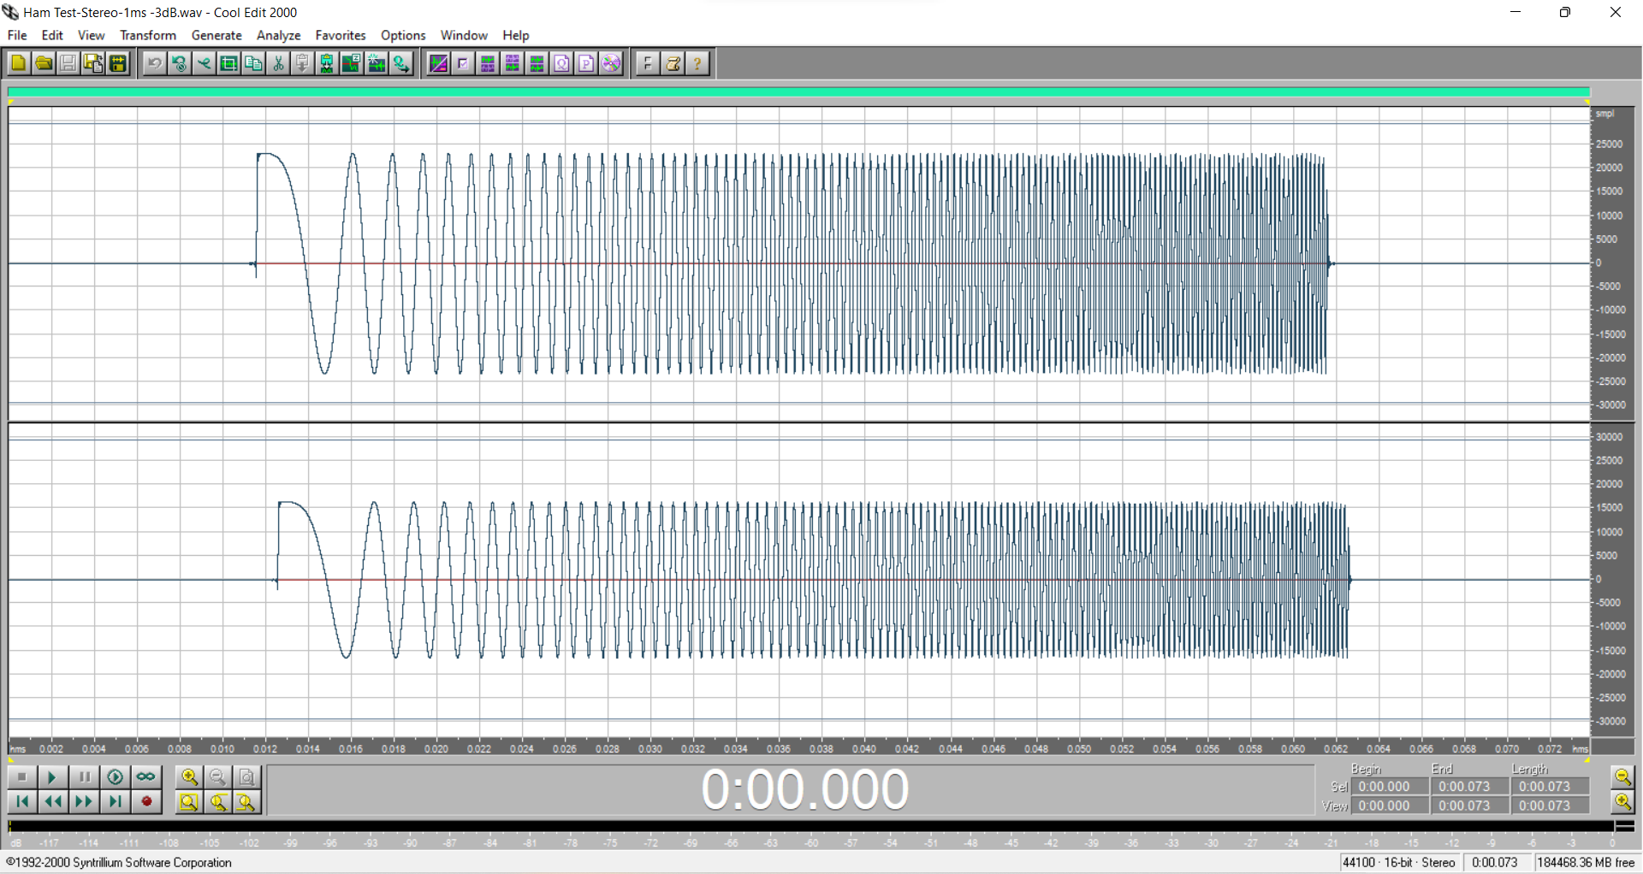
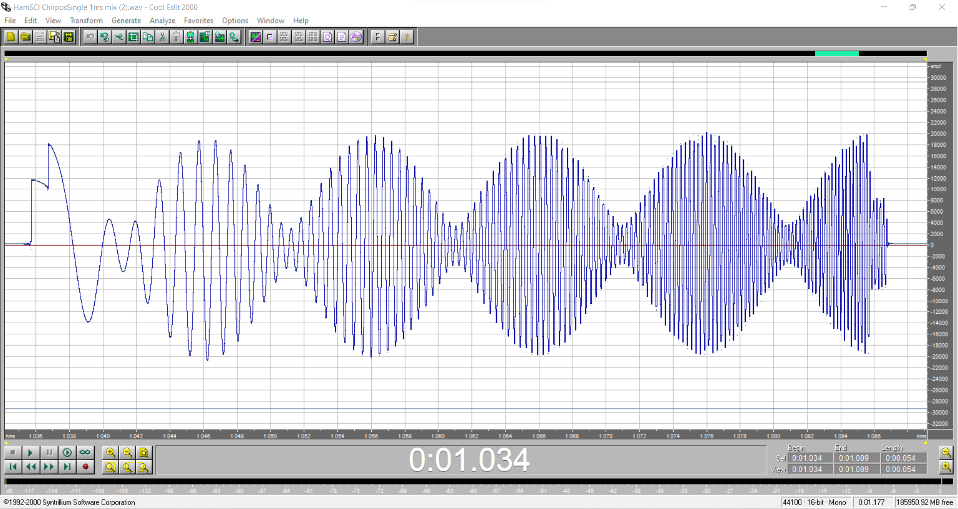
SUM
1 ms
p = 10 ms
Fig 2a. Two 100 Hz/ms Chirps with 1 ms Time Delay. Delayed Chirp is 3 dB lower in Amplitude.
Fig 2b. Summation produces a Waveform with a Beat Note of Period p = 10 ms.
Summation of a linear chirp with a delayed copy of itself produces a difference frequency at Δf = Sweep Rate * Δt.
Beat pattern has a period p = 1/Δf. The Time Difference of Arrival (TDOA) can be calculated by:
TDOA = 1/(p*Sweep Rate)
Example: two 100 Hz/ms chirps 1ms apart produce a difference frequency of 100Hz, which has a period of 10 ms.
TDOA = 1/(10 ms * 100 Hz/ms) = 1 s/1000 = 1 ms

Slide 15
Geometry and Setup for Initial TDOA On-Air Experiments Using Amateur Radio Stations WA5FRF and N5DUP
Geometry is convenient for proximity to expected eclipse Path and to the Austin Ionosonde for ground truth data.
The 60 m and 75 m frequency bands were chosen for likelihood of both 1 hop and 2 hop propagation.

Slide 16
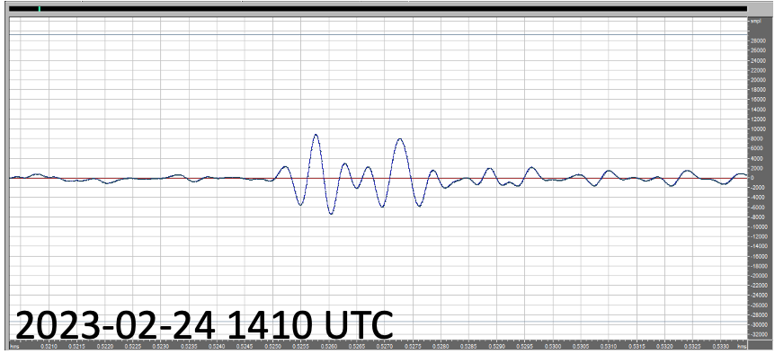
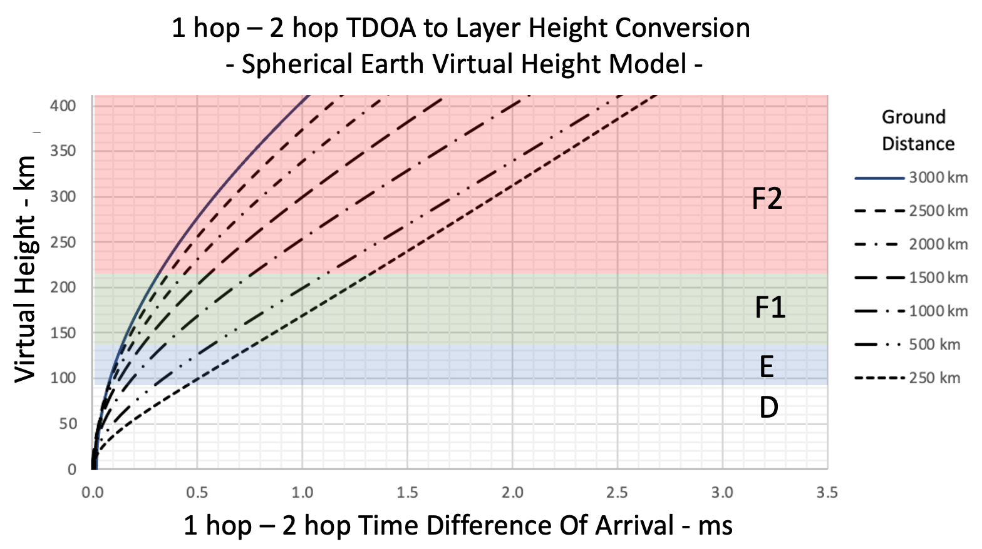
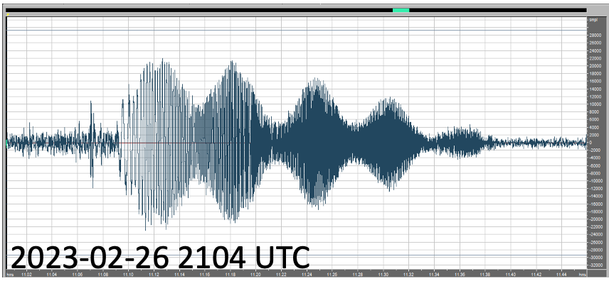
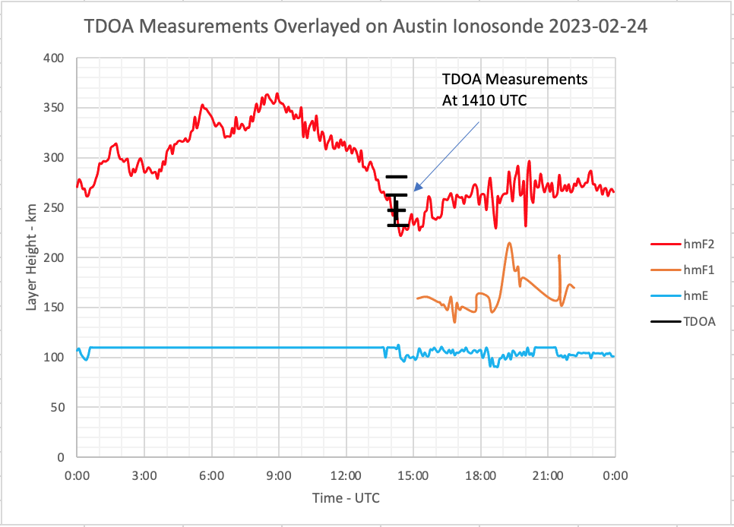
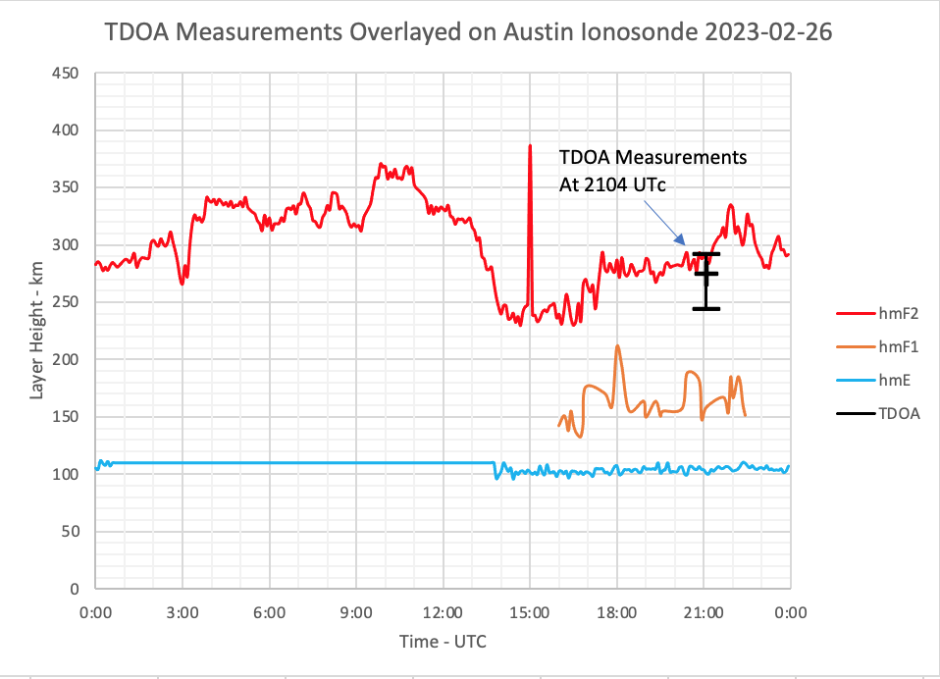
TDOA = 1.6 ms
TDOA = 1/(61 ms * 10 Hz/ms) = 1.6 ms
p = 61 ms
Fig. 4a Short Pulse and Chirp TDOA Measurements
Fig. 4b Convert 1.6 ms TDOA Measurements to 270 km Layer Height
Fig. 4c Overlay Layer Height Estimation on Ionosonde hmF2 Data for Day and Time of Measurement.
Error bars show range of 18 separate measurements using short pulses and 10-50 Hz/ms chirps.

